Slide 1
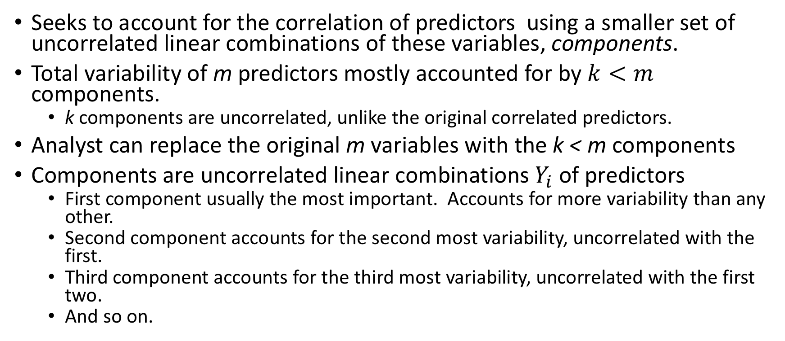
Principal Components Analysis (PCA)
Seeks to account for the correlation of predictors using a smaller set of uncorrelated linear combinations of these variables, components.
Total variability of m predictors mostly accounted for by $k<m$ components.
k components are uncorrelated, unlike the original correlated predictors.
Analyst can replace the original m variables with the k < m components
Components are uncorrelated linear combinations $Y_{i}$ of predictors
First component usually the most important. Accounts for more variability than any other.
Second component accounts for the second most variability, uncorrelated with the first.
Third component accounts for the third most variability, uncorrelated with the first two.
And so on.

Slide 2
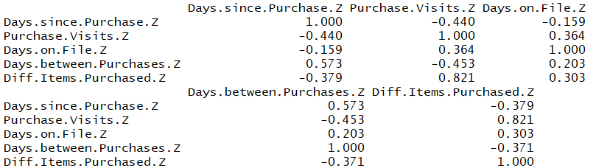

An Application of Principal Components Analysis
To illustrate: Estimate response Sales per Visit using Purchase Visits, Days on File, Days between Purchases, Different Items Purchased, and Days since Purchase.
Substantial correlation amongst the predictors.
Moderately inflated VIF metrics.

Slide 3
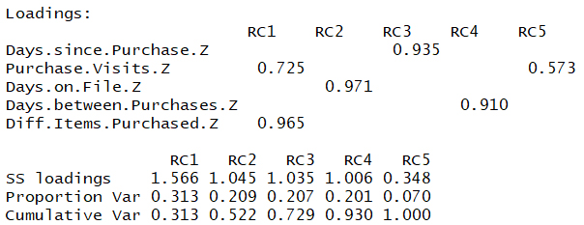
An Application of Principal Components Analysis
Perform PCA, using varimax rotation. Rotating helps interpretability.
If we extract only the first principal component, we account for 31.3% of the variance amongst predictors.
Extract two, account for 52.2%
How many should we extract?

Slide 4
How Many Components Should We Extract?
Motivation: reduce the dimensionality.
Should we retain only the first two principal components, since they explain over half (52% Cumulative Var) of the total variability
Should we retain all five components, since they explain 100% of the variability?
Retaining five does not help us to reduce the dimensionality.
The answer lies somewhere between these two extremes.

Slide 5
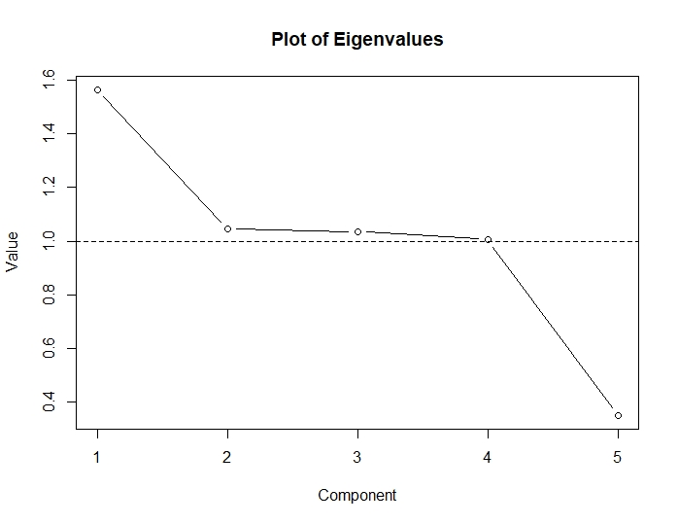
The Eigenvalue Criterion
Eigenvalues are “SS loadings”. 1.0 means the component would explain about “one predictor’s worth” of the total variability.
Each component should explain at least one predictor’s variability
Eigenvalue criterion: only components with eigenvalues greater than one should be retained.
Four of the rotated components have eigenvalues greater than one
The eigenvalue criterion therefore suggests that we extract k = 4 principal components.

Slide 6
The Proportion of Variance Explained Criterion
Specify proportion of total variability need explained
Select components until desired proportion is attained.
If we want 70%, choose components 1 – 3
If we want 90%, need to include component 4 as well
Without further input, we might say the proportion of variance explained criterion suggests either k = 3 or k = 4 components.
Since
eigenvalue criterion suggested k = 4 components, and
proportion of variance explained criterion says k = 3 or k = 4.
we settle on k = 4 components.

Slide 7
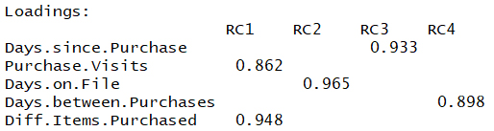
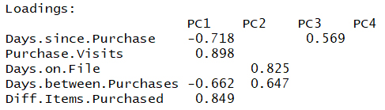
Performing PCA with k = 4
Rotated matrix
The first principal component is a combination of Different Items Purchased and Purchase Visits, which are positively correlated with each other
Had one of the weights been negative, then Different Items Purchased and Purchase Visits would be negatively correlated.
Remaining components are “singletons”, containing a single predictor each
Unrotated matrix
Interpretations less clear.
Component 1 is huge, containing four of the five predictors, with both positive and negative correlations mixed in.
Much cleaner is the interpretation of the rotated component matrix.

Slide 8
Validation of the Principal Components
Results should be validated using the test data set.
The four rotated components for the test set are similar to those for the training set
Did PCA alleviate our multicollinearity problem?
Examine:
The correlations among the four components, and
The correlation matrix for the principal components is zero, components are uncorrelated.
The predictor VIF for the regression of the response on the components.
VIFs equal 1, the minimum.

Slide 9
How to Perform Principal Components Analysis Using R
Separate data into X. Remember to standardize the predictor variables.
X <- clothes_train[, c(1:5)]; X_z <- as.data.frame(scale(X))
For correlation matrix, use cor().
round(cor(X_z), 3)
Install and open the psych package. principal() command performs PCA. r = X_z specifies variables to analyze. rotate = “varimax” performs varimax rotation. nfactors = 5 states we want five components.
install.packages("psych"); library(psych)
pca01 <- principal(r = X_z, rotate = "varimax", nfactors = 5); print(pca01$loadings, cutoff = 0.49)
Want loadings of the pca01 results, using cutoff = 0.49.
Eigenvalues of rotated components are under “SS Loadings”. Plot them.
ss.load <- c(1.566, 1.045, 1.035, 1.006, 0.348) plot(ss.load, type = "b", main = "Plot of Eigenvalues", ylab = "Value", xlab = "Component"); abline(h = 1, lty =2)
For correlation of components, run round(cor()).
round(cor(pca02_rot$scores),2)
To regress the target variable on the components, you may want to save each component as its own variable.
PC1 <- pca02_rot$scores[,1]; PC2 <- pca02_rot$scores[,2]; PC3 <- pca02_rot$scores[,3]; PC4 <- pca02_rot$scores[,4]

Slide 10
When is Multicollinearity Not a Problem?
Multicollinearity may not present a fatal defect.
“does not adversely affect the ability of the sample regression equation to predict the response variable.”
does not significantly affect point estimates of the target variable, confidence intervals for the mean response value, or prediction intervals for a randomly selected response value.
Must limit use of a multicollinear model to estimation and prediction.
Interpretation would not be appropriate, since the individual coefficients may not make sense.
Models not accounting for multicollinearity may be used for estimation, but not for description or interpretation.

